Slide 1
Project Presentation of Co-op Project at Industry (Module-1)
On
Code Audit
Sarthak Jyoti Mishra
(2210990801)
Supervised By
Dr. Shikha
Assistant Professor
Chitkara University
Department of Computer Science and Engineering,
Chitkara University, Punjab

Slide 2
Index
Objective
Introduction
Methodology, Approach & Techniques
Algorithm
Flow Chart
Result
Conclusion
Future Scope
Reference

Slide 3
Objective
To develop an AI-powered code auditing system that analyzes code in real time and provides instant, actionable feedback.
To offer personalized coding challenges and suggestions that help developers identify weaknesses and improve best practices.
To enable performance tracking and progress analysis through dashboards and reports for continuous skill improvement.

Slide 4
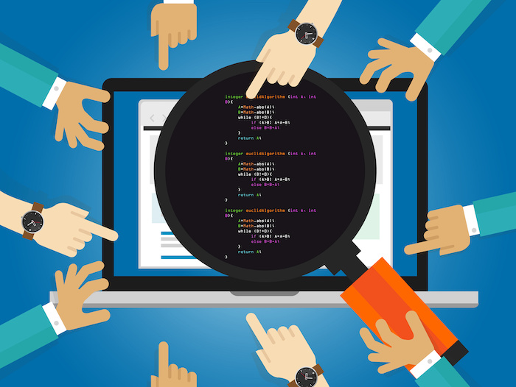
INTRODUCTION
Transitioning from learning to building real-world software often depends on the quality of coding practice and feedback.
Developers and students struggle with understanding mistakes, optimizing code, and following best practices due to a lack of personalized, real-time guidance.
Traditional methods like static tutorials, offline code reviews, or generic coding platforms do not adapt to individual learning paths or provide actionable feedback.
CodeAudit fills this gap by:
Offering AI-driven code review in real-time, while coding or after submission
Providing instant feedback with suggestions for improvements and best practices
Tracking coding progress and patterns over time through analytics
4

Slide 5
Methodology, Approach & Techniques
Agile Methodology is used to develop the system in iterative phases with regular testing and feedback.
A user-centric approach is followed to ensure simple navigation, real-time feedback, and an engaging learning experience.
The system is designed using a client–server architecture, separating frontend presentation from backend processing.
Frontend Development: Built using React.js and Tailwind CSS to create a responsive, interactive, and user-friendly interface.
Backend Development: Implemented using Node.js and Express.js to handle business logic, API requests, and AI integration.
AI & Analysis Techniques: Integrated Gemini AI for real-time code evaluation, error detection, and optimization suggestions.
Data & Security Techniques: Used MongoDB for data storage and JWT + BcryptJS for secure authentication and authorization.

Slide 6
Algorithm
The user logs in or registers using a secure authentication system, ensuring protected access and personalized tracking of coding activity.
The user selects the coding topic, programming language, and difficulty level, allowing the platform to customize challenges based on the user’s skill set.
The AI engine generates relevant coding challenges, and the developer writes and submits solutions directly on the platform for evaluation.
The system performs an instant AI-based code review, providing detailed explanations, improvement suggestions, and corrected code snippets.
The user can download the complete code review and optimized solution in PDF format for offline study and revision.
The dashboard and report card are updated automatically, tracking performance, identifying weak areas, and showing progress over time.

Slide 7
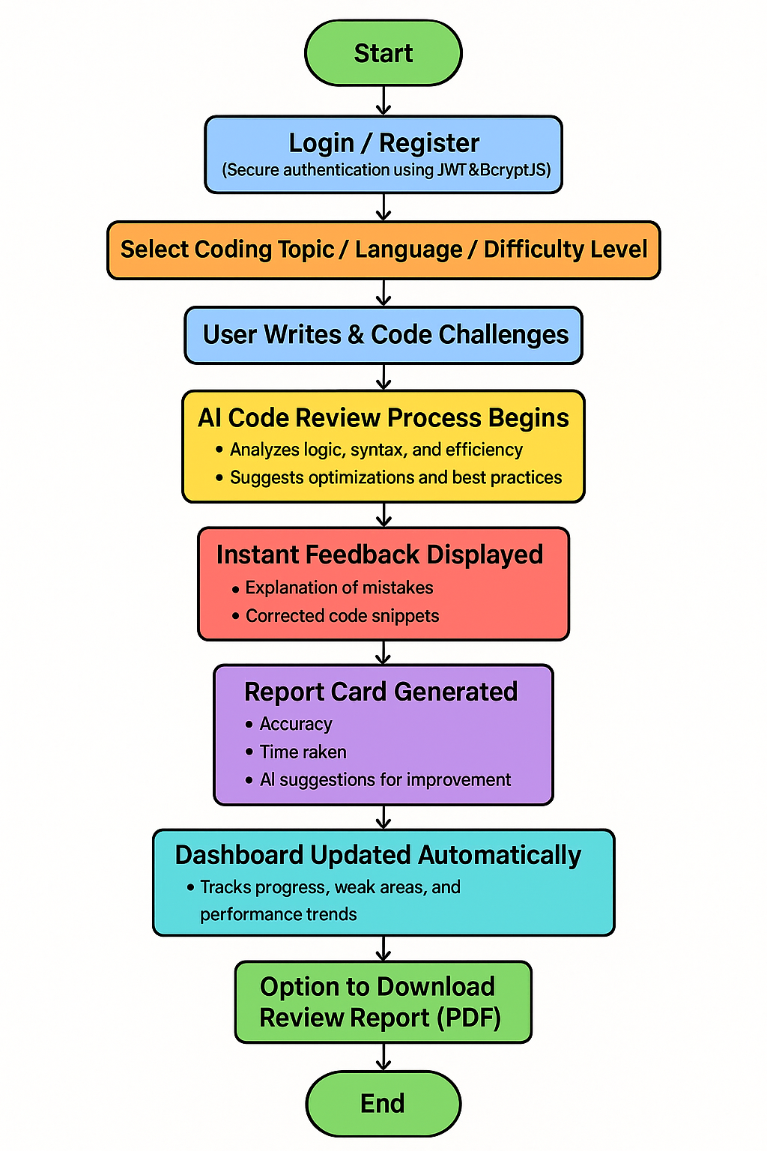
FLOWCHART

Slide 8
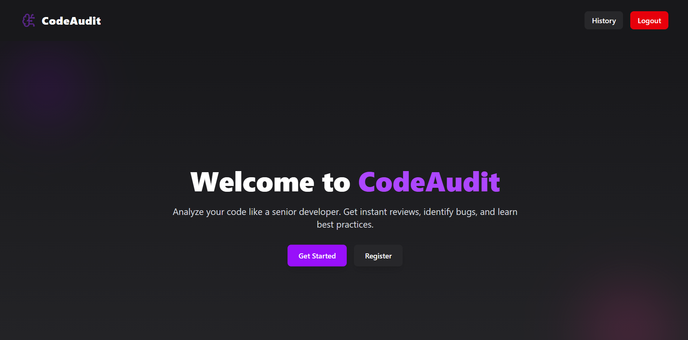
RESULT

Slide 9
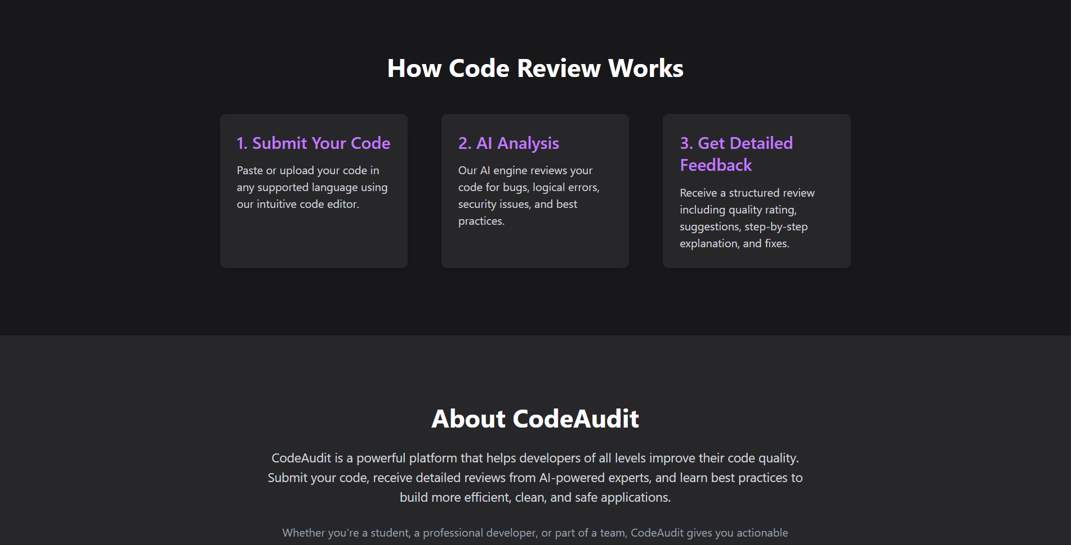

Slide 10
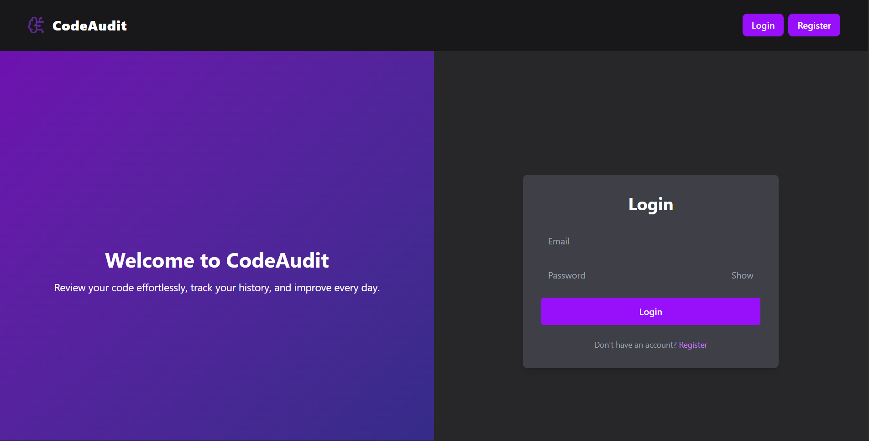

Slide 11
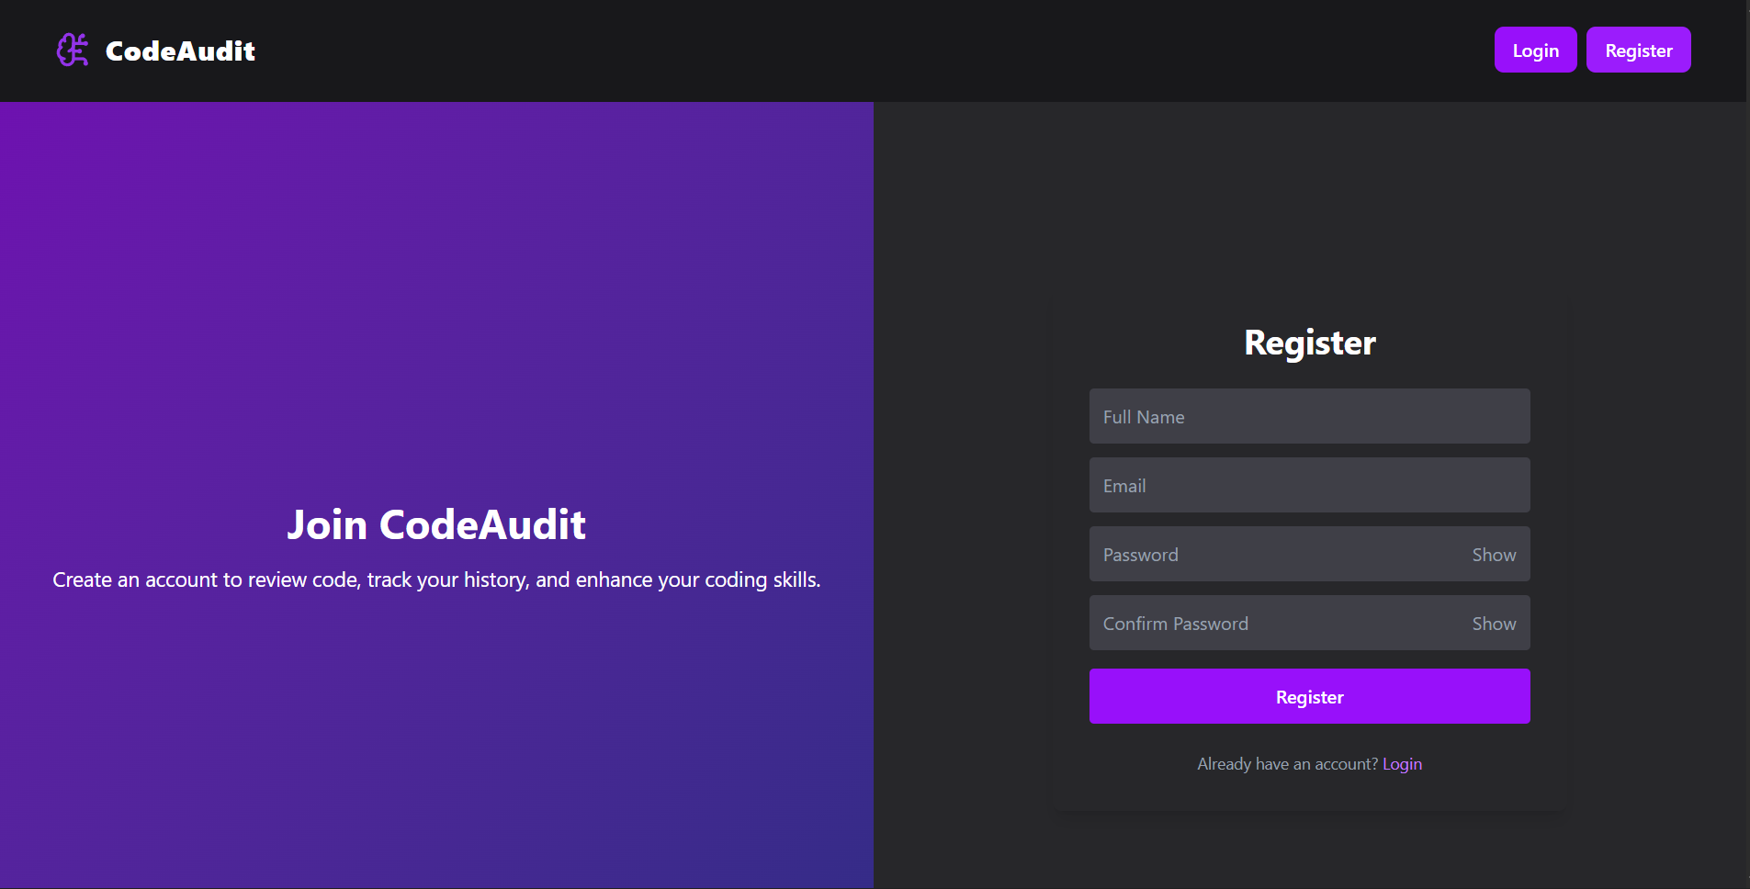

Slide 12
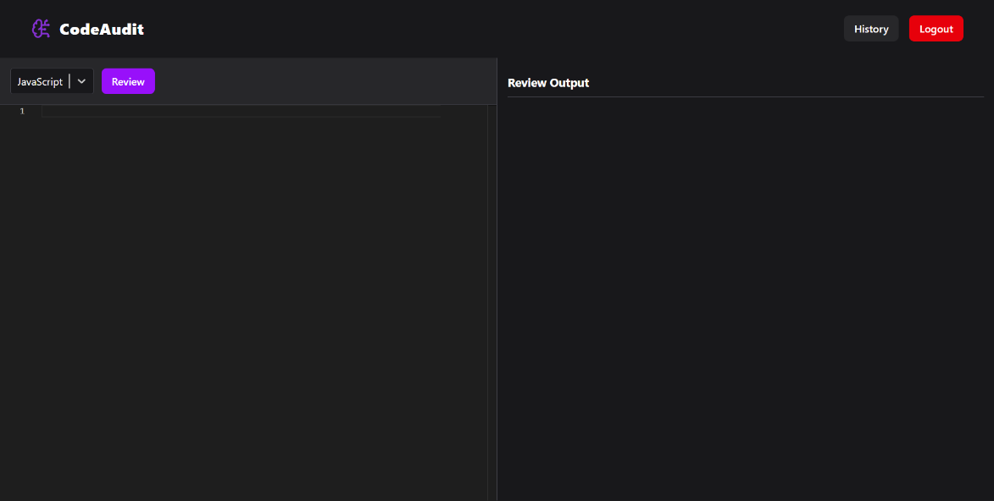

Slide 13
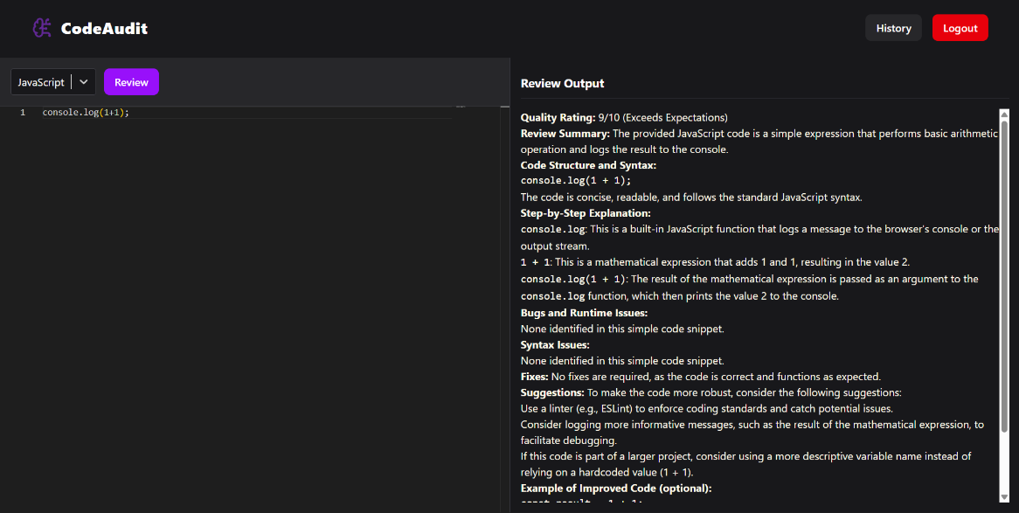

Slide 14
CONCLUSION
Code Audits revolutionizes interview preparation by:
Combining AI + analytics + modern web tech.
Offering personalized, interactive, and insightful code reviews.
Tracking coding patterns & weak areas continuously.
Enabling coders to code smart, not just hard.
IMPACT:
Builds confidence.
Provides structured preparation.
Improves code quality for real-world applications.

Slide 15
Future Scope
Integration of support for more programming languages and frameworks to broaden usability across different developer domains.
Enhancement of the AI model to provide deeper semantic code analysis, including design pattern detection and security vulnerability checks.
Addition of real-time collaborative code review, allowing multiple users or mentors to review and discuss code simultaneously.
Inclusion of interview simulation and competitive programming modes to help users prepare for real-world technical assessments.
Development of a mobile application for on-the-go coding practice and performance tracking.
Advanced career-oriented analytics and recommendations, guiding users toward skill improvement paths based on industry demands.

Slide 16
REFERENCES
React.js
Official Documentation: React Documentation
GitHub Repository: React GitHub
Node.js & Express.js
Node.js Documentation: Node.js Official Docs
Express.js Documentation: Express Official Docs
MongoDB
Official Documentation: MongoDB Documentation
GitHub Repository: MongoDB GitHub
Tailwind CSS
Official Documentation: Tailwind CSS Documentation
GitHub Repository: Tailwind CSS GitHub
Vite Groq

Slide 17
Thank You
17

